Slide 1
IP and MAC Addresses Lab

Slide 2
IP and MAC Addresses Lab
Materials needed
Computer system connected to internet
Software Tools used
terminal and command prompt
system preferences (MAC OS)
settings (Windows)

Slide 3
IP and MAC Addresses Lab
Remember…
IP Addresses are not permanent
They change depending on which network the device is connected to
MAC Addresses are permanent
They do not change from network to network

Slide 4
IP and MAC Addresses Lab
The following lab will show how to locate IP and MAC addresses across different operating systems
Find the IP and MAC Address of your system
Windows Operating System
MAC Operating System
Linux Operating System

Slide 5
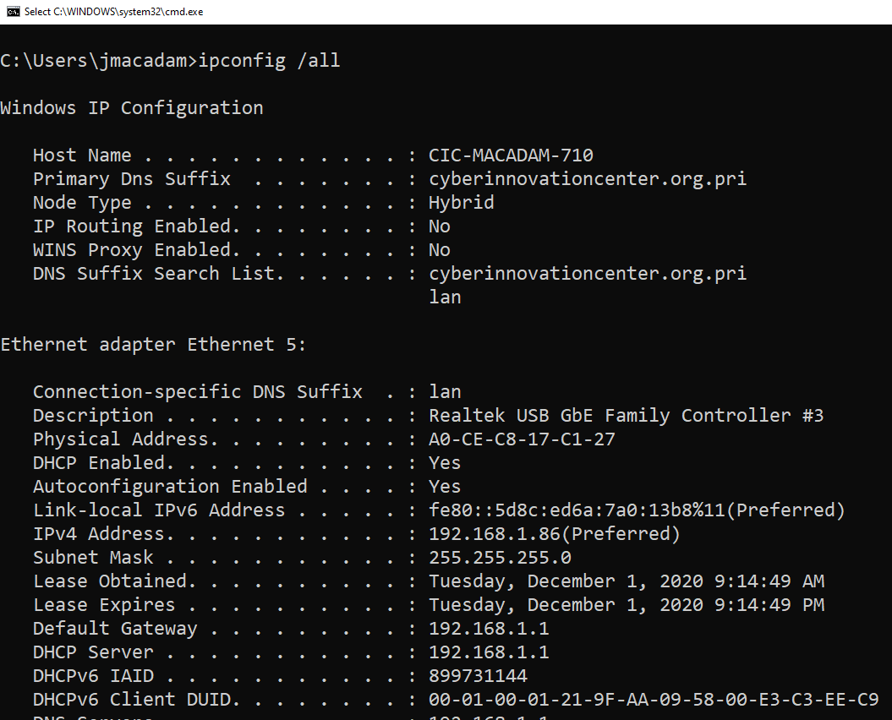
IP and MAC Addresses Lab
Windows Command Prompt
Open a Command Prompt window
Windows Key + r, type cmd, and hit enter
Type the command ipconfig /all
MAC Address
IP Address

Slide 6
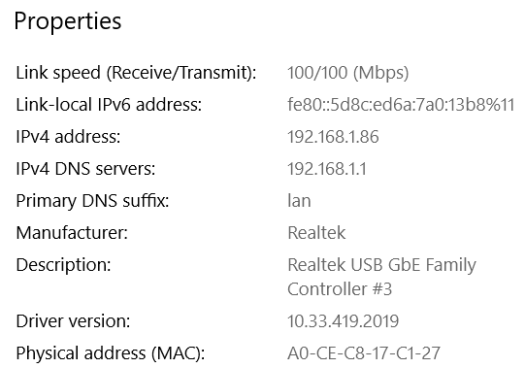
IP and MAC Addresses Lab
Windows Settings
On Windows 10, select Start and then click Settings (the gear icon)
Select Network and Internet
Select Status and then properties
IP Address
MAC Address

Slide 7
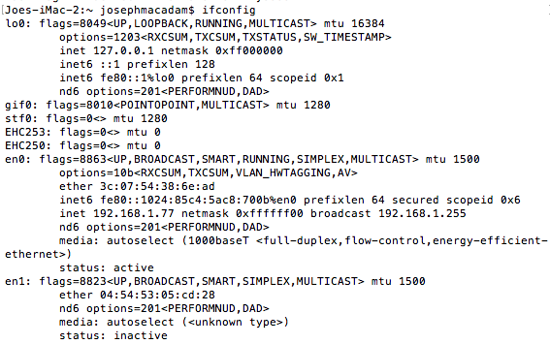
IP and MAC Addresses Lab
Mac Terminal
Open Terminal
Enter the command ifconfig
MAC Address
IP Address

Slide 8
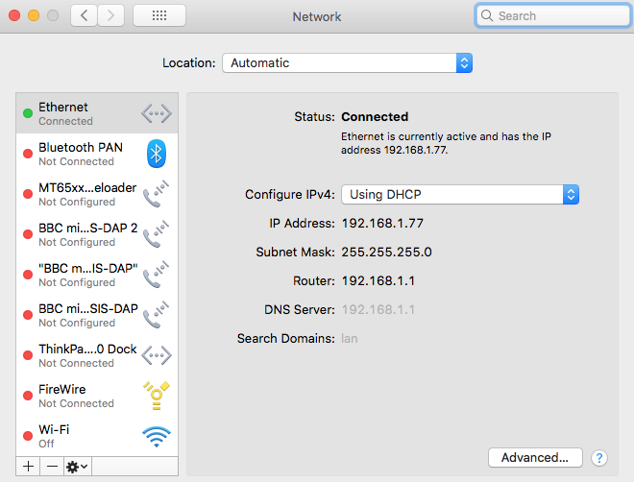
IP and MAC Addresses Lab
Mac System Preferences
Select System Preferences from the Apple menu in the top left corner
Select Network
IP Address

Slide 9
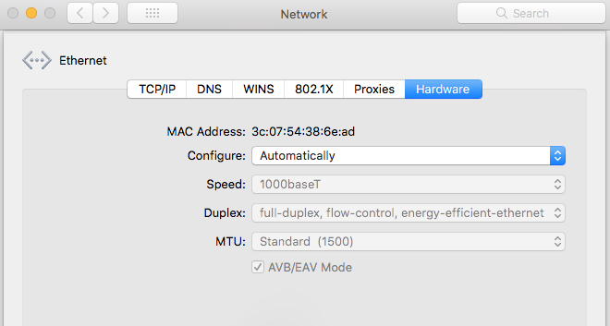
IP and MAC Addresses Lab
Mac System Preferences
Continuing from the previous slide, click the Advanced button
Select Hardware
MAC Address

Slide 10
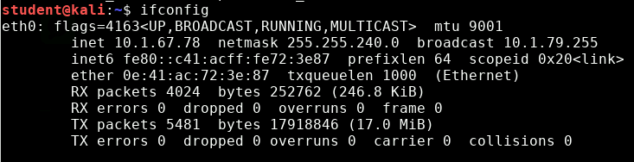
IP and MAC Addresses Lab
Linux Terminal
Open Terminal
Enter the command ifconfig
IP Address
MAC Address

